Slide 1
UNIT - 4
FUNCTIONS AND POINTERS

Slide 2
FUNCTION
Functions is a sub-program that contains one or more statements and it performs some task when called.

Slide 3
Types
Functions
Pre-Defined
Functions
User-Defined
Functions

Slide 4
Pre-Defined Functions
The pre-defined functions or library functions are built-in functions.
The user can use the functions, but cannot modify the function.
Example: sqrt()

Slide 5
User-Defined Functions
The functions defined by the user for their requirement are called user-defined functions.
Whenever it is needed, The user can modify the function.
Example: sum(a,b)

Slide 6
Advantage of User-Defined Functions
The length of the source program can be reduced.
It is easy to locate error.
It avoid coding of repeated instructions.

Slide 7
Elements of User-Defined Function
Function declaration
Function definition
Function call

Slide 8
Function
Syntax
datatype function_name (parameters list)
{
local variable declaration;
…………………………
body of the function;
…………………………
return(expression);
}

Slide 9
How Function Works
Once a function is called the control passes to the called function.
The working of calling function is temporarily stopped.
When the execution of called function is completed then the control return back to the calling function and execute the next statement.

Slide 10
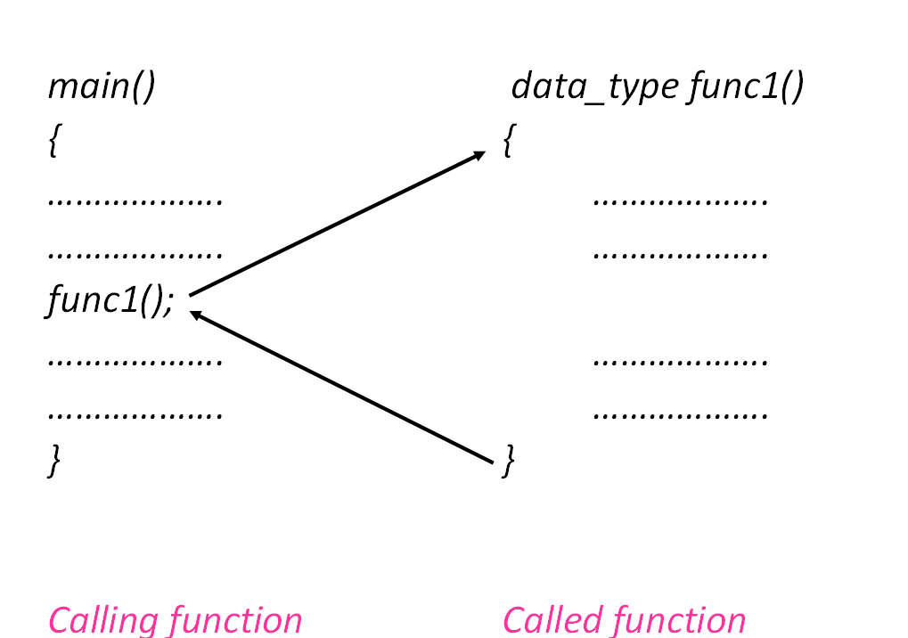

Slide 11
Parameters
Actual Parameter
These are the parameters transferred from the calling function to the called function.
Formal Parameter
These are the parameters which is used in the called function.

Slide 12
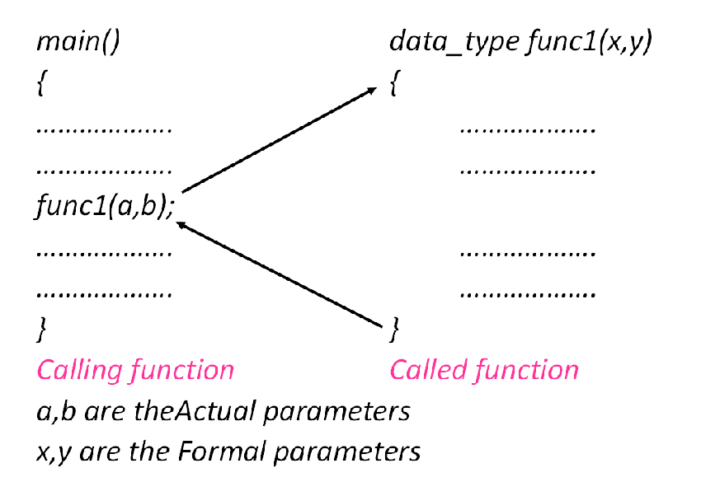

Slide 13
return Statement
The return statement may or may not send some values to the calling function.
Syntax:
return; (or)
return(expression);

Slide 14
Function Prototypes
Function with no arguments and no return values.
Function with arguments and no return values.
Function with arguments and return values.
Function with no arguments and with return values.

Slide 15
1. Function with no arguments and no return values
Here no data transfer take place between the calling function and the called function.
These functions act independently, i.e. they get input and display output in the same block.

Slide 16
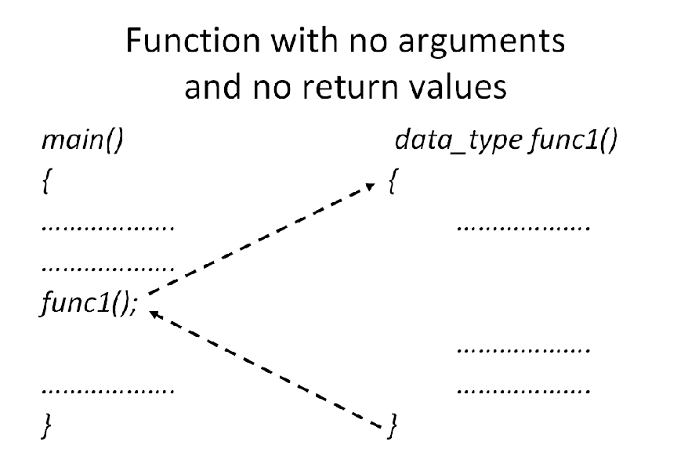

Slide 17
Example
#include <stdio.h>
#include<conio.h>
void add();
void main() //calling function
{
clrscr()
add();
getch();
}
void add() //called function
{
int a,b,c;
printf("\nEnter two number:");
scanf("%d%d",&a,&b);
c=a+b;
printf("\nSum is:%d",c);
}

Slide 18
Output
Enter two number:3
4
Sum is:7

Slide 19
2. Function with arguments and no return values
Here data transfer take place between the calling function and the called function.
It is a one way data communication, i.e. the called program receives data from calling program but it does not return any value to the calling program.

Slide 20
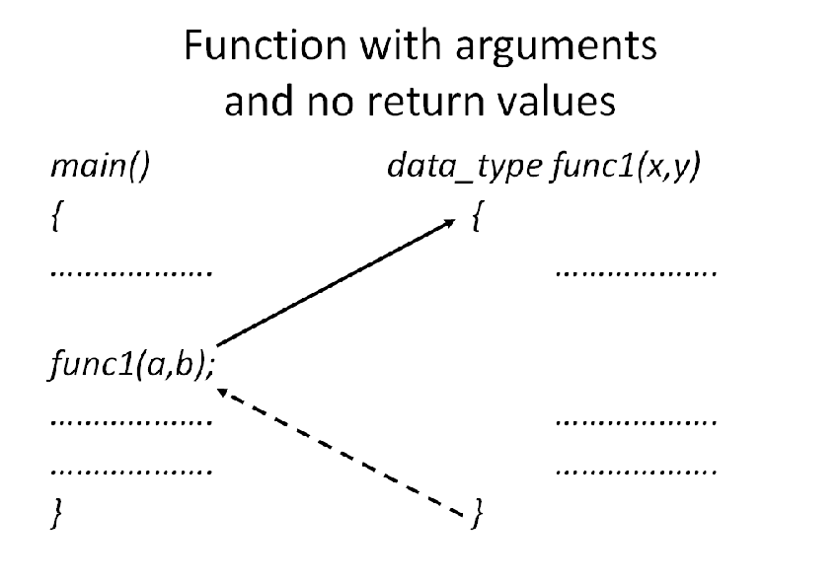

Slide 21
Example
#include <stdio.h>
#include<conio.h>
void add(int,int);
void main()
{
int a,b;
clrscr();
printf("\nEnter two number:");
scanf("%d%d",&a,&b);
add(a,b);
}
void add(int x,int y) //function with arguments
{
int z;
z=x+y;
printf("\nSum is:%d",z);
}

Slide 22
Output
Enter two number:2
4
Sum is:6

Slide 23
3. Function with arguments and return values
Here data transfer take place between the calling function and the called function as well as between called function and calling function .
It is a two way data communication, i.e. the called program receives data from calling program and it return some value to the calling program.

Slide 24
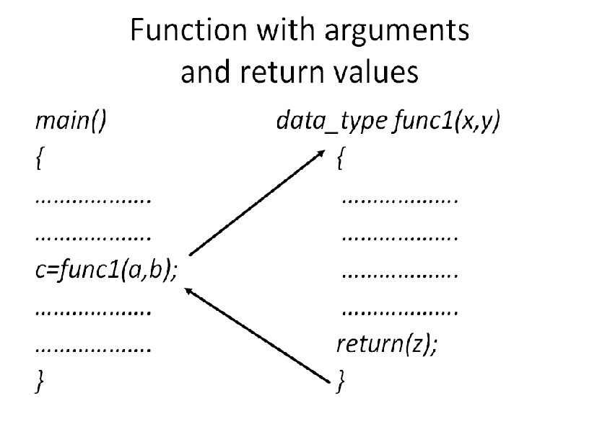

Slide 25
Example
#include <stdio.h>
#include<conio.h>
int add(int,int);
int main()
{
int a,b,c;
clrscr();
printf("\nEnter two number:");
scanf("%d%d",&a,&b);
c=add(a,b);
printf("\nSum is:%d",c);
}
int add(int x,int y)
{
int z;
z=x+y;
return(z);
}

Slide 26
Output
Enter two number:6
7
Sum is:13

Slide 27
4. Function with no arguments and with return values
Here data transfer take place between the called function and the calling function.
It is a one way data communication, i.e. the called program does not receives data from calling program but it return some value to the calling program.

Slide 28
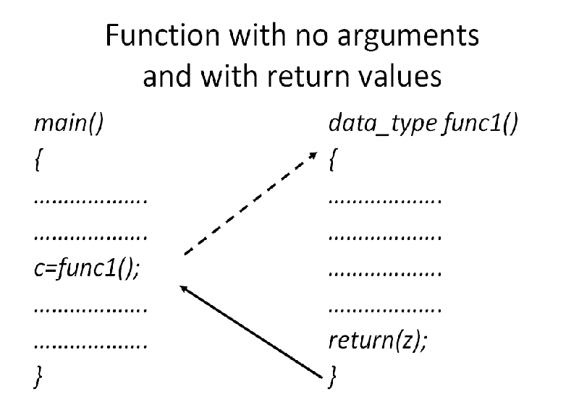

Slide 29
#include <stdio.h>
#include<conio.h>
int add();
int main()
{
int d;
d=add();
printf("\nSum is:%d",d);
}
int add()
{
int a,b,c;
printf("\nEnter two number:");
scanf("%d%d",&a,&b);
c=a+b;
return(c);
}

Slide 30
Output
Enter two number:5
8
Sum is:13

Slide 31
Parameter Passing Methods
Call by value
Call by reference

Slide 32
Call by value
Actual argument passed to the formal argument.
Any changes to the formal argument does not affect the actual argument.

Slide 33
Example
#include <stdio.h>
#include<conio.h>
int add(int,int);
int main()
{
int a,b,c;
clrscr();
printf("\nEnter two number:");
scanf("%d%d",&a,&b);
c=add(a,b);
printf("\nSum is:%d",c);
}
int add(int x,int y)
{
int z;
z=x+y;
return(z);
}

Slide 34
Output
Enter two number:6
7
Sum is:13

Slide 35
Call by reference
Instead of passing value, the address of the argument will be passed.
Any changes to the formal argument will affect the actual argument.

Slide 36
Example
#include <stdio.h>
#include<conio.h>
void swap(int*,int*);
void main()
{
int x,y;
printf("\nEnter value of x:");
scanf("%d",&x);
printf("\nEnter value of y:");
scanf("%d",&y);
Output
Enter value of x:5
Enter value of y:6
x=6,y=5
swap(&x,&y);
printf("\nx=%d,y=%d",x,y);
}
void swap(int *a,int *b)
{
int c;
c=*a;
*a=*b;
*b=c;
printf("\nx=%d,y=%d",*a,*b);
}

Slide 37
Recursion
It is a process of calling the same function itself again and again until some condition is satisfied.
Syntax:
func1()
{
………..
func1();
}

Slide 38
Example
#include<stdio.h>
#include<conio.h>
int fact(int);
int main()
{
int a;
clrscr();
printf("\nEnter the number:");
scanf("%d",&a);
printf("The factorial of %d! is %d",a,fact(a));
}

Slide 39
int fact(int x)
{
int f;
if(x==1)
return(1);
else
f=x*fact(x-1);
return(f);
}
Output:
Enter the number:5
The factorial of 5! is 120

Slide 40
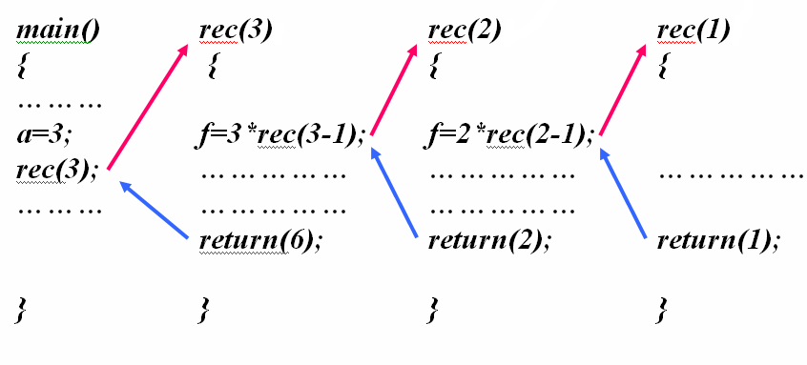
Example: Working of 3!

Slide 41
Library Function
It is pre-defined function.
The library function provides functions like mathematical, string manipulation etc,.

Slide 42
Example
sqrt(x):
It is used to find the square root of x
Example: sqrt(36) is 6
abs(x):
It is used to find the absolute value of x
Example: abs(-36) is 36
pow(x,y):
It is used to find the value of x^{y}
Example: pow(5,2) is 25
ceil(x):
It is used to find the smallest integer greater than or equal to x
Example: ceil(7.7) is 8

Slide 43
rand():
It is used to generate a random number.
sin(x):
It is used to find the sine value of x
Example: sin(30) is 0.5
cos(x):
It is used to find the cosine value of x
Example: cos(30) is 0.86
tan(x):
It is used to find the tan value of x
Example: tan(30) is 0.577

Slide 44
toascii(x):
It is used to find the ASCII value of x
Example: toascii(a) is 97
toupper(x):
It is used to convert lowercase character to uppercase.
Example: toupper(‘a’) is A
toupper(97) is A
tolower(x):
It is used to convert uppercase character to lowercase.
Example: tolower(‘A’) is a

Slide 45
Pointers
Pointer is a variable that contains the memory address of another variable.

Slide 46
Example:
x=5
x Variable
1002 Address
5
Value

Slide 47
Example
#include<stdio.h>
#include<conio.h>
void main()
{
int x=5;
printf("\n The Address of x = %u",&x);
printf("\n The Value of x = %d",x);
}
Output
The Address of x = 8714
The Value of x = 5

Slide 48
Pointer Declaration
Syntax
data-type *pointer-name;
data-type - Type of the data to which the pointer points.
pointer-name - Name of the pointer
Example: int *a;

Slide 49
Accessing Variable through Pointer
If a pointer is declared and assigned to a variable, then the variable can be accessed through the pointer.
Example:
int *a;
int x=5;
a=&x;

Slide 50
Example
#include<stdio.h>
#include<conio.h>
void main()
{
int x=5;
int *a;
a=&x;
printf("\n The Value of x = %d",*a);
printf("\n The Address of x = %u",a);
}

Slide 51
Output
The Value of x = 5
The Address of x = 8758
The Value of a = 8758
The Value of x = 5

Slide 52
Example:
#include<stdio.h>
#include<conio.h>
void main()
{
int y=10;
int *a;
a=&y;
printf("\n The Value of y = %d",y);
printf("\n The Address of y = %u",&y);
printf("\n The Value of a = %d",a);
printf("\n The Address of a = %u",&a);
}

Slide 53
a
y
Variable
Value
Address
5001
10
8000
5001

Slide 54
Output
The Value of y = 10
The Address of y = 5001
The Value of a = 5001
The Address of a = 8000

